Slide 1

Introduction to ASYN Design, Features and Usage

Slide 2
The ASYN Framework
Parts and concepts
Functional and data interfaces
ASYN processing: asynchronous and synchronous
Advantages
Tracing and debugging
Use cases

Slide 3
ASYN Parts and Concepts
Generic EPICS Device Support for all record types
No need to write Device Support
Pluggable named ports
One thread per blocking port
ASYN does thread handling, queueing, locking, protection
Named data type interfaces
Drivers implement interfaces based on their data types
Interpose layers
Allow building layered protocol stacks from reusable blocks
Tracing facility

Slide 4
ASYN Port Interfaces
Functional
Connection handling
Status
Tracing and error handling
Data
Octet (stream of bytes)
Int32, UInt32
Float64
Arrays: Int8, Int16, Int32, Float32, Float64
Enum
Opaque pointer

Slide 5
ASYN Processing: Synchronous
Scanner thread
Record Support
PACT=0
ASYN DevSup
Callback
ASYN
Lock port
Unlock port
Port Driver
Blocking IO

Slide 6
Record Processing: Synchronous
Scanner thread
Record Support
PACT=0
Device Support
Driver Support
Blocking IO

Slide 7
ASYN Processing: Asynchronous
Scanner thread
Port thread
Callback thread
Record Support
PACT=0
PACT=1
ASYN DevSup
Leaving PACT=1
Request processing
Callback
ASYN
work queues
Lock
Unlock
Port Driver
Blocking IO

Slide 8
Record Processing: Asynchronous
Scanner thread
IRQ
Callback thread
Record Support
PACT=0
PACT=1
Device Support
Leaving PACT=1
Request processing
Driver Support
IO Request
IO Response

Slide 9
ASYN Advantages
Minimizes user code
ASYN handles all the complex parts:
Device Support layer
Thread handling
Proper resource locking
Queueing (by priority)
Ports Drivers can be stacked
High level Port Driver for a device (data interfaces)
Low level Port Driver for a connection (octet interface)

Slide 10
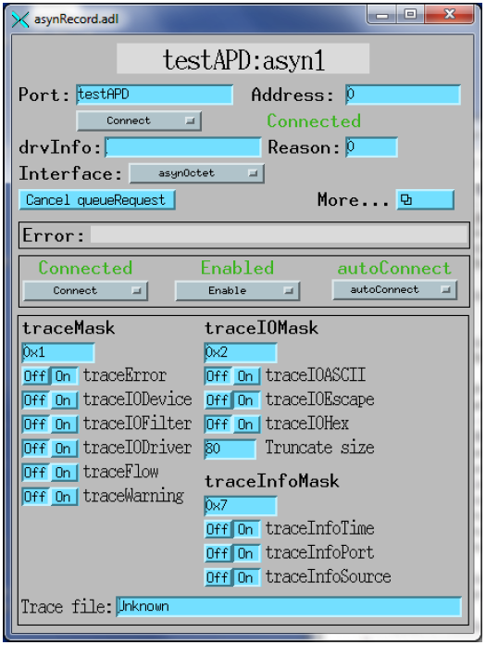
Tracing and Debugging
ASYN trace facility enforces streamlined debug and error messages
asynRecord provides access to full ASYN capabilities for debugging (useful to have one of those on each IOC that uses ASYN)

Slide 11
asynPortDriver C++ Base Class
Using the C API requires a lot of boilerplate:
Creating handles
Registering ports and interfaces
Calling interrupt clients
…
asynPortDriver takes care of all this
Adds generic parameter get/set facility
Using this C++ base class is the recommended way to create a Port Driver

Slide 12
Applications 1) Swapping a Driver
Instrument (vacuum pump) on a serial connection
Lab setup: serial line connected to IOC
Production setup: serial line to terminal server, IOC connects through TCP/IP
ASYN can at startup (or in the live system) switch the low level (octet) driver from drvAsynSerialPort to drvAsynIPPort, without changing the high level driver (for the pump) or the EPICS database

Slide 13
Applications 2) Swapping a Protocol
Siemens PLC (with SPSS communication package) using the next version of S7Asyn driver
ASYN can at startup switch the high level (items in PLC data block) driver from Raw TCP block read/write to the Native S7 protocol, without changing the EPICS database.

Slide 14
Applications 3) Adding a Checksum
Device offers same protocol on TCP/IP and RS232, but the RS232 needs checksums after each message.
An ASYN interpose module can implement the calculation/adding (on send) and check/removal (on receive) of a checksum.
Then the low level (octet) driver can again be switched from drvAsynSerialPort with checksum interpose to drvAsynIPPort, without changing anything above.

Slide 15
Conclusion
ASYN extends the somewhat sloppy EPICS device interface
Device driver framework with pluggable reusable modules
Data type specific interfaces (instead of record type)
Interpose modules to implement protocol stacks
Tracing/debugging support
Convenience C++ base class
Questions?

Slide 16
EPICS Device Interface
IOC architecture: EPICS support layers
Traditional Device and Driver Support APIs
Record processing: synchronous and asynchronous
Caveats

Slide 17
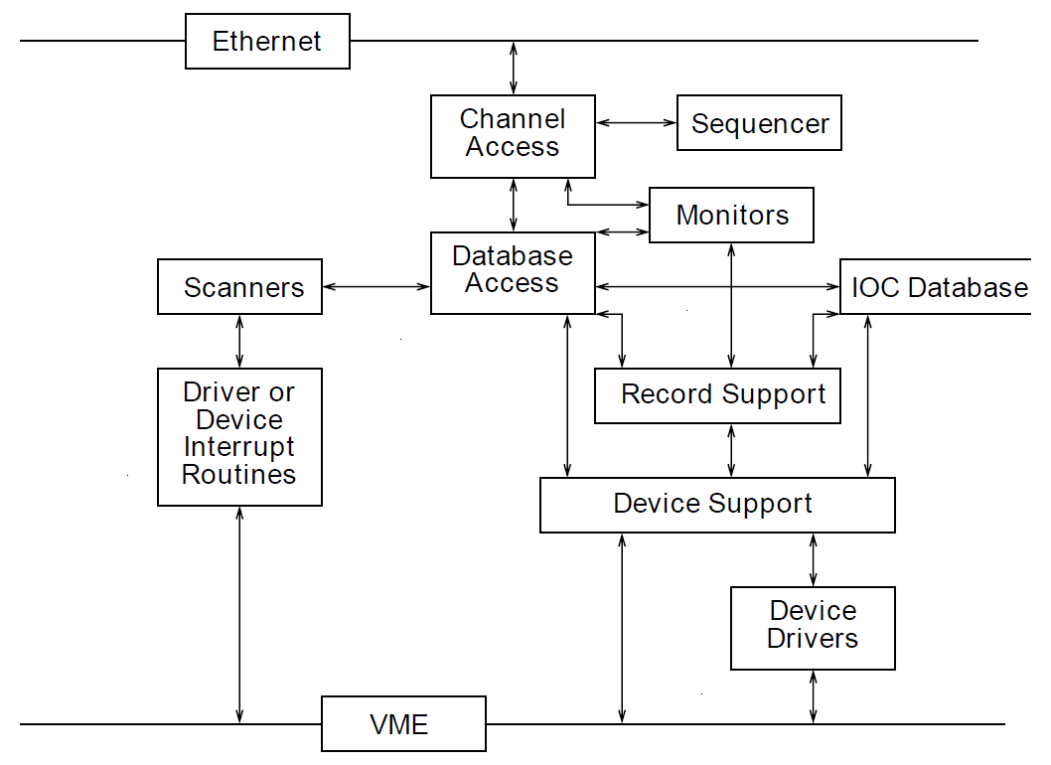
IOC Architecture
APIs are
Well defined
Well defined
Pretty well defined
Poorly defined

Slide 18
Device and Driver Support APIs
Device Support: jump table per record type
report
init (once per support)
init (per record instance)
rec type specific io (read or write)
get interrupt info (if interrupt scan is supported)
rec type specific calls (e.g. conversion factor update)
Driver Support: jump table
report
init
…

Slide 19
Classical Device/Driver Support
Needs to implement Device Support functions for all supported record types
For a multi-purpose device easily ~10 record types
Must understand how all these record types work
Uses private API between Device and Driver Support
Device Support is strongly coupled to a Driver
Making it practically impossible to swap the Driver (to use e.g. a different serial line IO board)
Each Device/Driver support has their own API, style and format for debugging/tracing

Slide 20
Record Processing: Synchronous
Scanner thread
Record Support
PACT=0
Device Support
Driver Support
Blocking IO

Slide 21
Record Processing: Asynchronous
Scanner thread
IRQ
Callback thread
Record Support
PACT=0
PACT=1
Device Support
Leaving PACT=1
Request processing
Driver Support
IO Request
IO Response

Slide 22
Asynchronous Processing Caveats
Multi-threaded environment
Often processing/waiting is offloaded to separate threads
All access to shared data (record, buffers, queues) between threads must be properly guarded by semaphores
Record priorities
Three priority levels, configured in record instance
Device Support architecture should support this
Actually: most Device Supports don’t

Slide 23

Thank You for Your Attention!
Credits:

